Slide 1


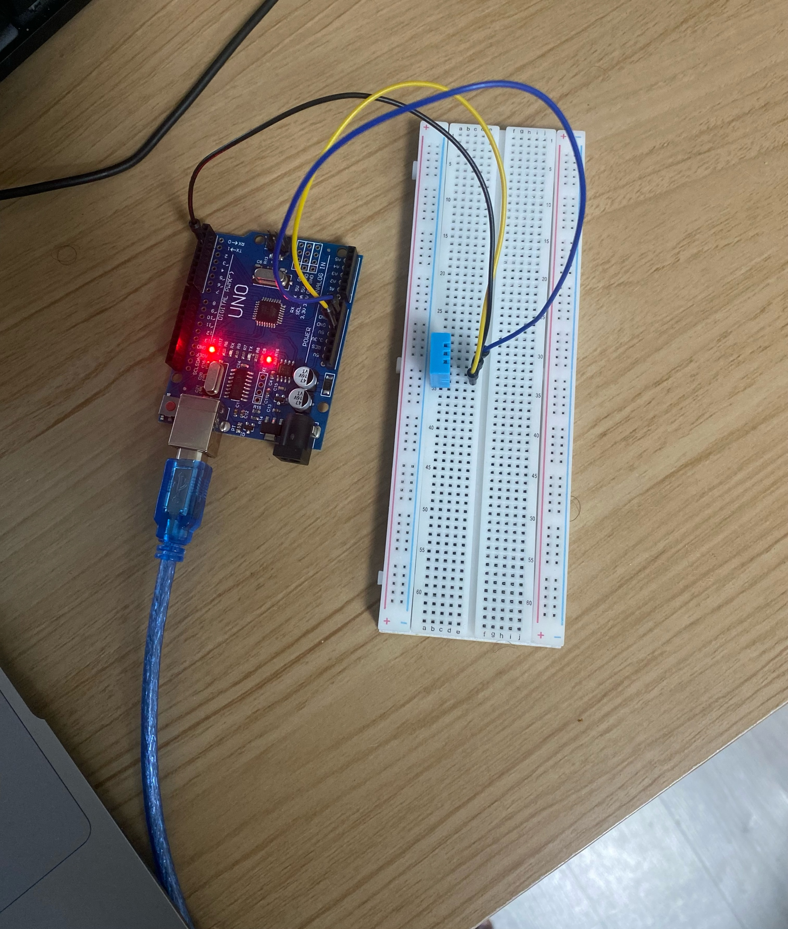
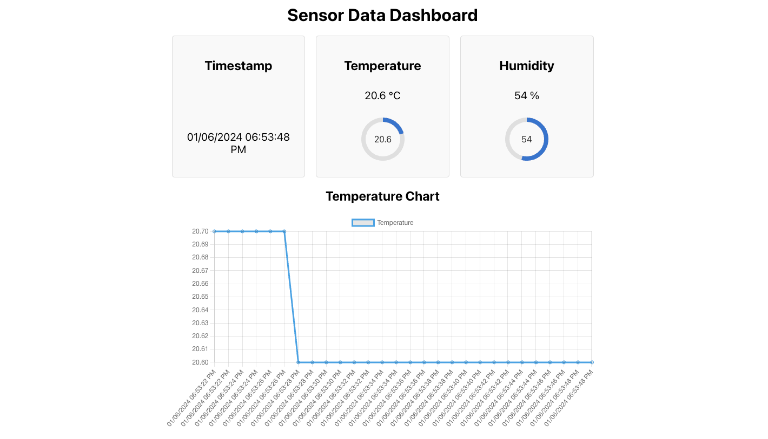
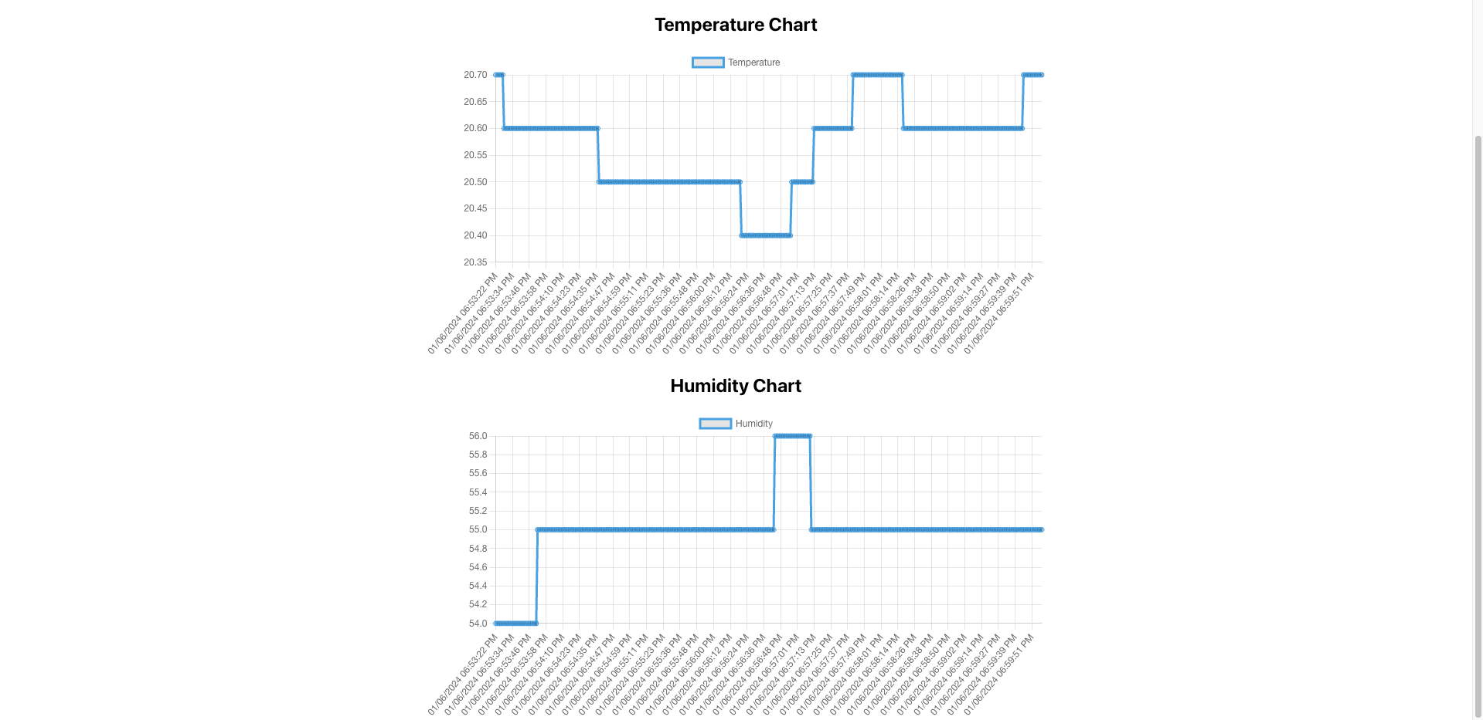
IoT-Based Smart Weather Monitoring System
JUMALE ABDI JILLO, USAMA ADHAN SULEIMAN, ADAH LUBWAMA
Supervised by: Baseem Al-athwari, Ph.D.,
Department of Smart Computing,
Kyungdong University, Republic of Korea
INTRODUCTION
The Internet of things (IoT) describes the network of physical objects—a.k.a. "things"—that are embedded with sensors, software, and other technologies for the purpose of connecting and exchanging data with other devices and systems over local network and/or the Internet.
The project aims to develop an IoT-based real-time sensor data monitoring system that captures temperature and humidity data using a DHT11 sensor connected to an Arduino. The data is transmitted via a serial port to a backend server, which processes and broadcasts it to a frontend application. This system allows for continuous monitoring and visualization of environmental conditions, providing valuable insights for various applications.
IMPLEMENTATION
1. Frontend: Built with React.js, it includes:
LineCharts: Shows historical temperature and humidity data using time interval of 1 sec.
2. WebSocket Connection: Ensures real-time data updates from the backend server.
3. Backend: Uses Node.js, Express.js, WebSocket, and SerialPort for:
Data Reception: From Arduino via serial port.
Data Processing: Parses data and adds timestamps.
WebSocket Broadcasting: Sends updates to clients.
4. Arduino: Equipped with a DHT11 sensor to measure temperature and humidity, sending data to the backend for timely and accurate updates.
IoT COMPONENTS
A.DHT11 SENSOR
The DHT11 sensor is a crucial compone
nt of IoT setups, measuring temperature and humidity levels. Interfacing with microcontrollers like Arduino, it provides essential environmental data for processing and transmission.
B. ARDUINO
Acting as the central processing unit, the Arduino microcontroller reads data from sensors like the DHT11. It interprets this data and sends it to the backend server for further analysis, while also potentially executing additional tasks based on the sensor readings.
C. SERIAL PORT
The serial port serves as a communication interface between the Arduino and the backend server. It enables the transfer of sensor data in a serial format, ensuring seamless communication and continuous flow of information for real-time or periodic updates.
D. WEBSOCKET
WebSocket technology facilitates real-time data transmission between the backend server and the frontend application. By establishing full-duplex communication channels, WebSocket enables instantaneous updates of sensor data without the need for manual refreshing, enhancing user experience and data accessibility.
E. REACT FRONTEND
The React frontend application visualizes sensor data received from the backend server in real time. Utilizing Chart.js, it dynamically renders charts and graphs to represent environmental conditions such as temperature and humidity. This interactive presentation empowers users to make informed decisions based on the data insights provided.
F. NODEJS BACKEND
Serving as the intermediary between the Arduino and the frontend, the React backend processes incoming sensor data and prepares it for transmission to the frontend application. It manages data flow, performs necessary computations, and ensures data integrity before relaying it to the frontend for visualization.
Physical View
CONCLUSION
In summary, the integration of IoT components such as the DHT11 sensor, Arduino microcontroller, serial port communication, WebSocket technology, React frontend, and React backend forms a robust system for monitoring and analysing environmental data in real time. Each component plays a crucial role in gathering, processing, transmitting, and visualizing sensor data, thereby enabling users to make informed decisions based on the insights provided.
ACKNOWLEDGMENT
We would like to give our deep sense of gratitude and heartful thanks to our project mentor Baseem Al-athwari, Ph.D. for being the constant source of encouragement from selection of topic to implementation and further.

